Slide 1
Northampton General Hospital, 8th May 2018
Anatomical Pathology
in an age of
Collaborative Networks
& Digital Pathology
Arrigo Bondi
Anatomia, Istologia Patologica e Citodiagnostica
Ospedale Maggiore Bologna, Italia
Notes:
This is a pathologist’s point of view and I understand that this title drives us to active interactions
within the hospital and toward the digital world in our old laboratories.
One of my friends, a colleague, told me: I got a slide scanner! Wonderful, it is in my room!!
Of course, this is not the right place where it should stay.

Slide 2
  Whole digital slide: the virtual slide in a real lab
  Rethink the role: clearly distinguish the Pathologist’s task from the laboratory activities
Pathologist is a doctor
Pathologist’s place is close to clinicians
Notes:
To adopt the whole digital slide, or the virtual slide in our labs we must consider some points:
It is important to distinguish clearly the Pathologist's role from that of the laboratory technician:
pathologist is a doctor, pathologist’s place is close to clinicians.
In this contest, I wonder is it necessary to have the lab next door too?

Slide 3
  Whole digital slide: the virtual slide in a real lab
Hi Tech Laboratory
Modern & hight quality instruments
High volumes productivity
Investment management and professional skills in economics
Shareable between several groups of Pathologists
Notes:
Is it better to have our own, essential lab or a high tech shared lab? We need good and productive
instruments and investments. All these characteristics leads to a shared laboratory.

Slide 4
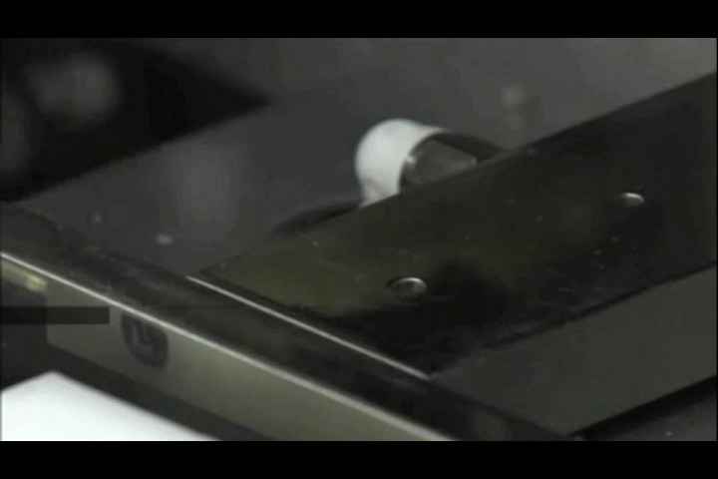
Notes:
Paraffin blocks cutting machine: this example impressed me because I know that the slide preparation is really a difficult task and so hard to automatize

Slide 5

OM
B Cornee
P 29
Pad 18
Imola
P 8
Pad 26
OB
Rizzoli
Neuro
Notes:
I am going to expose a local experience of the town of Bologna: we are trying to organize a
network of labs, not a simple fusion, with the goal to guarantee the presence of the pathologists
within each hospital.

Slide 6
  How informatics can change Pathology
Reorganization of the histopathology laboratories in a wide area
LIS & whole digital slide are the key for success
Notes:
LIS and whole digital slides are strategic to reach the goal.

Slide 7



GI
Breast
Accettazione
Dimissione
Lymph
Blood
Notifica
Soft T.
Pediatric
Bone
  Diagnostic digital Pathology work:
cases back for competence and not by origin
Notes:
In other words, we have many hospitals that need histopathology experts: we can concentrate on
preparing the slides in a "cloud lab" while the pathologists remain in hospitals and receive the
slides, digital slides, according to their competence and not by origin.

Slide 8
Information System (LIS)
Lab
Writing the Report
Reception
Billing
Managing System for
Anatomic Pathology
Notes:
Some time ago, the LIS was dedicated to record the arrival of the case and handle billing, and when word processing became available, also writing reports. No real interaction with the laboratory even when the machines of the clinical pathologist were already widely interconnected.
In the reorganization, LIS is strategic.

Slide 9
Key words
Lab Managing
Traceability
Whole Digital Slide
Reporting
Notes:
A managing system with special characteristics is necessary for pathologists today, that records
the tracking of operations, accomplishes the digital slide and gives assistance in drafting the
report.

Slide 10
Information System (LIS)
Lab
Writing the Report
Reception
Billing
Anatomic Pathology
Notes:
And it is much more involved in the laboratory.

Slide 11
Key words
Lab Managing
  Planning
  Empower the Workers
Traceability
  Q-probes
Whole Digital Slide
Reporting
Notes:
Workers must be involved il planning the LIS and traceability must be part of the quality system

Slide 12
Ultimate Solutions
depend on view
of the problems
Executive leader
Supervisor / Manager
Line worker
R. Zarbo, Am.J.Surg.Pathol. 131:468,2009
Notes:
Considering technicians and doctors in the analysis greatly increases the potential for problem solving.
The point of view matter: the boss is interested in the top of the system, but a deeper vision can show crucial details, and you know, the devil is there, in the details!
Richard Zarbo from Chicago proposed a method for the analysis

Slide 13
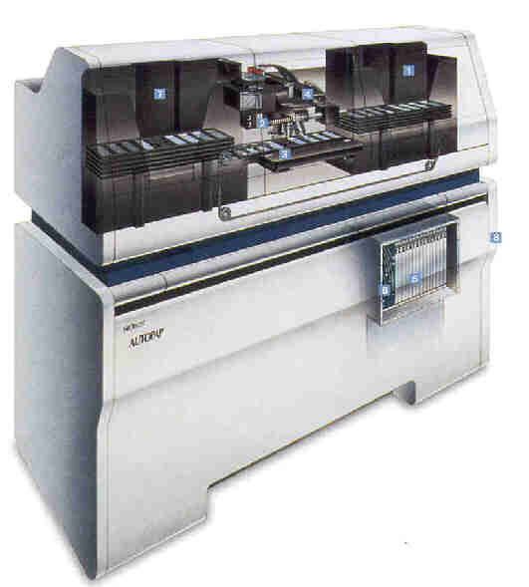
Lean Production
Work flow and Paths Analysis
Worker position, performances, optimization
Setting machines
Notes:
Consider each detail and each worker, position, time, functions.
He applied the so called LEAN PRODUCTION SYSTEM

Slide 14

Lean Production
What is it ?
It identifies an industrial philosophy inspired by the Toyota Production System, which aims
to minimize wastes up to annul them
Wasted resources, wasted time, inaccuracies: Record events and errors, analyze and correct
Notes:
It is not a matter of size, it is a strategy philosophy first applied in car industry, and then extended to other fields, including health labs

Slide 15
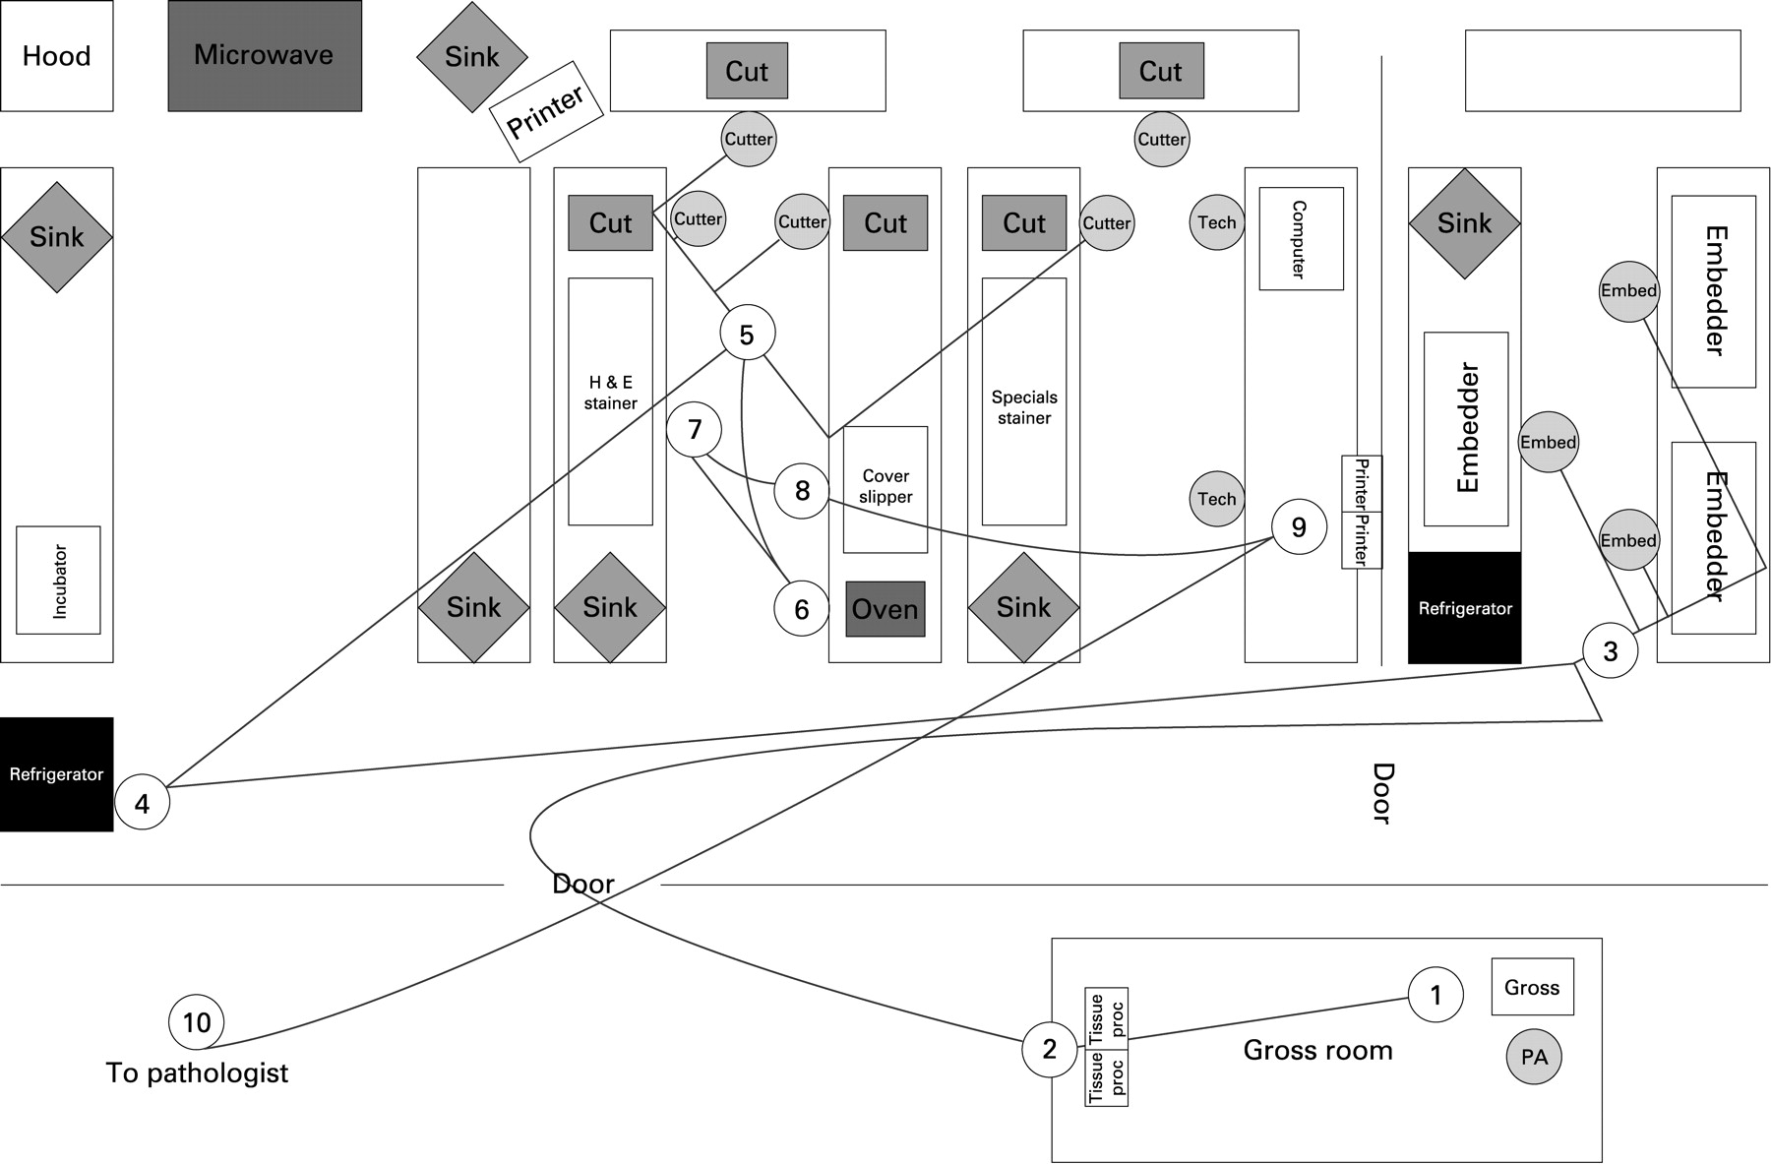

Lean Production
Analyzes on movements and times of operators and samples
like a bloodhound
Notes:
In the deep analysis the workers’ cohoperation in essential

Slide 16
Key words
Lab Managing
  Planning
  Empower the Workers
Traceability
  Q-probes
Whole Digital Slide
Reporting
Notes:
Traceability is part of the quality assurance

Slide 17
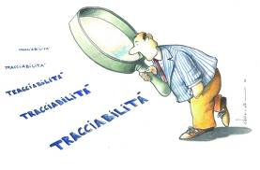
Traceability: what is it?
It is the ability to verify the history, location, modifications and responsibilities of an item
(product or activity)
by means of documented recorded identifications
(ISO 8402/1992)
Notes:
What do we mean with traceability in surgical pathology?

Slide 18
Why trace in Surg Pathol ?
Document quality (Q-Probe)
The main product items
During the process of production
What trace in Surg Pathol ?
When trace in Surg Pathol ?
Notes:
Trace the production and record events just when they happens

Slide 19
The main product of the Pathologist is the diagnosis
Traceability
Track whatever can affect the product and the way to accomplish it
diagnosis
Notes:
Documenting production: in the case of the production of pathologists this means the diagnostic pathway

Slide 20


Key elements for traceability
Target definition
Path analysis
Object identification
Documentation
Notes:
What is the best way to ensure traceability?
Follow the road to the treasure and be clever to come back and take it home!

Slide 21
Target & Pathway
Diagnosis
  Documents, reports
Microscope analysis
  Sections, stains
Object preparation
  Slides, blocks
Specimens
  Containers, requests
Notes:
And where leave the stones toward the diagnosis?
We need to consider each element that we use to reach the goal, in each phase of the process.
We need to document and trace all these items, individually

Slide 22
Unambiguous objects identification
Numbering the "case" (application for examination)
Identify each inclusion
Identify each slide, each stain ...
Identify significant portions of a slide ... the coordinates that points the diagnostic area
Notes:
In an unique way
But it is not enought.
Histopathologist make the diagnosis inside the slide, not only with a slide

Slide 23
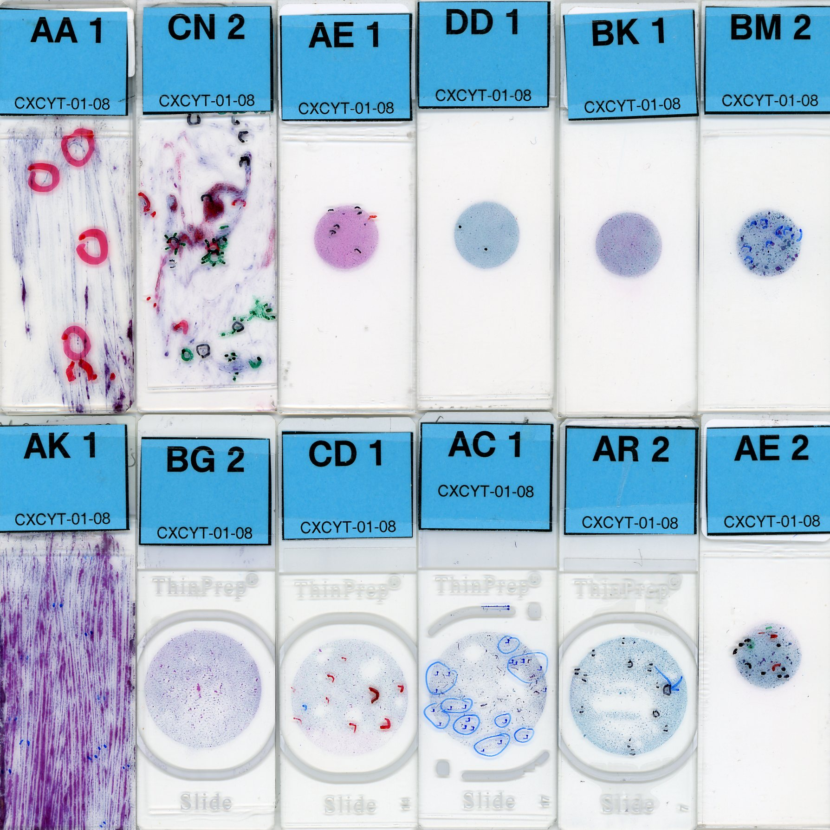







Notes:
This is what I mean by identifying the important part of the slide, the position coordinates of the single diagnostic image

Slide 24
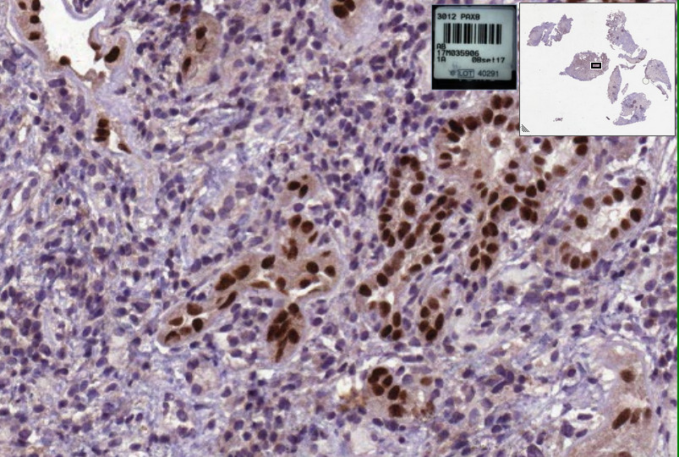
Notes:
The digital slide is perfect in Targeting the the diagnostic images

Slide 25
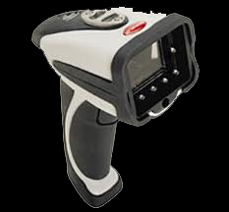

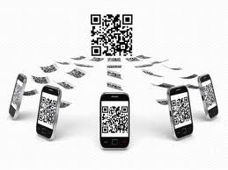
Means for traceability
Notes:
To implement traceability we need tools to identify quickly and automatically the objects to be traced: at the moment the QR-codes are the best tool.

Slide 26
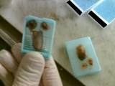
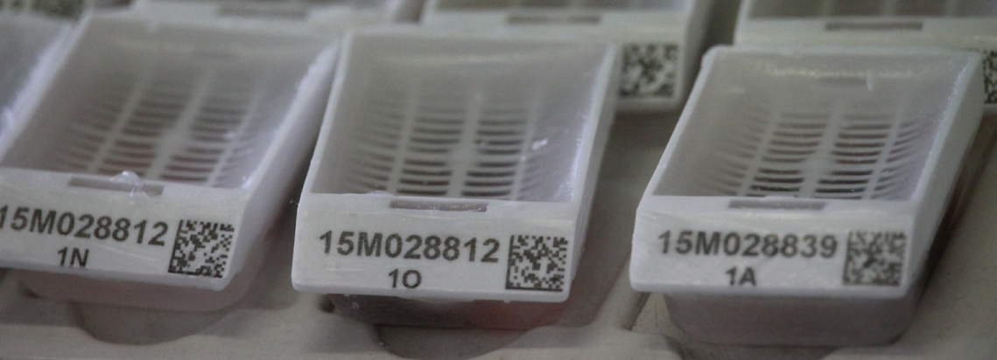
Unambiguous objects identification
Notes:
For an unique identification of used items

Slide 27
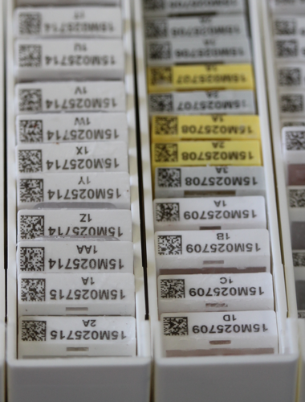
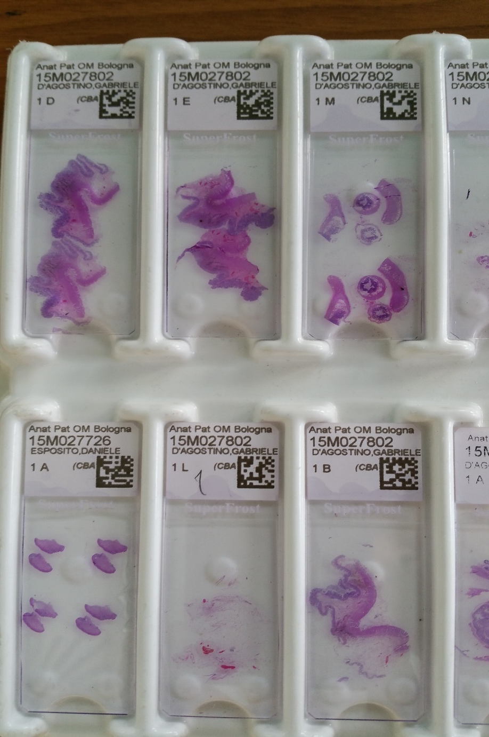
Unambiguous objects identification

Slide 28
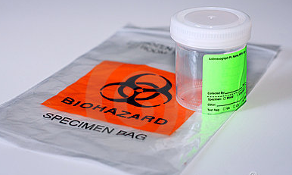
Order Entry
Surgery
  Uniqueness of the samples begins with the examination request
  Labelling
Tracking documents
Request
Notes:
Traceability must start in the surgery room, when the histopathology needing starts

Slide 29
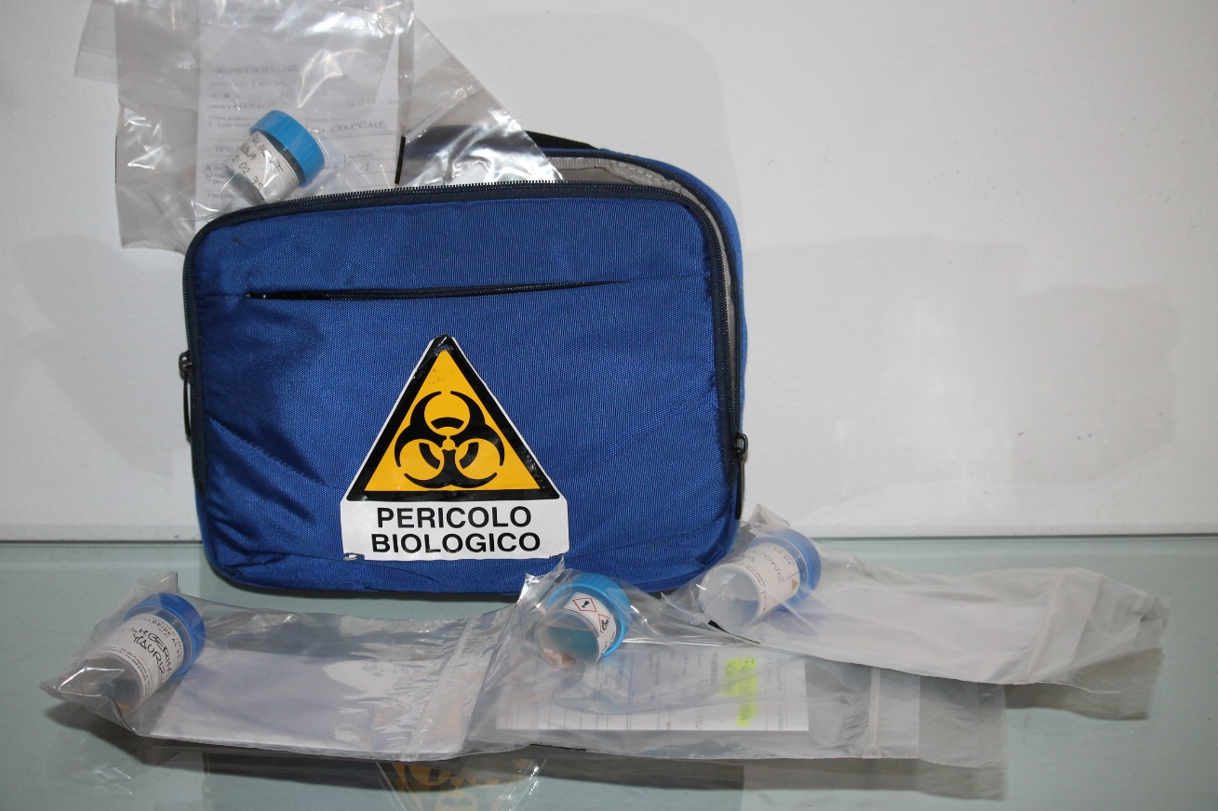
Order Entry – Standard elements
Notes:
Must accompany the specimens toward the lab

Slide 30
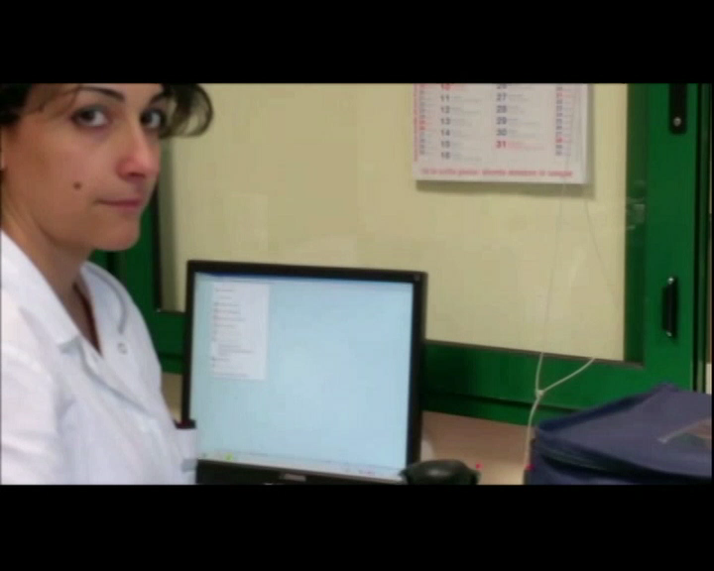
Notes:
And verify each step.
When the transport bag is opened, each sample must have already been labeled and the technician has only the task of recognizing and verifying it.

Slide 31
Key words
Lab Managing
Traceability
Whole Digital Slide
  … in the real world !!
Reporting
Notes:
I image a full integration of the digital slide in the diagnostic process

Slide 32
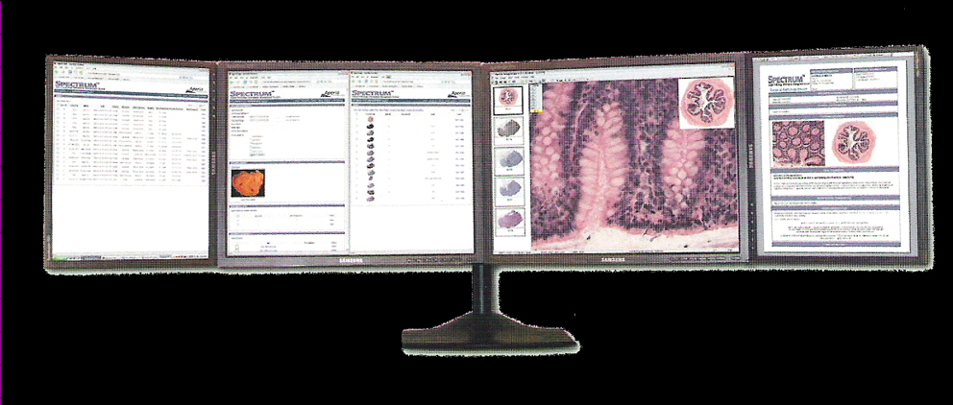
Working Station for
Anatomic Pathology
Clinic
Report
Macro
Microscope
Molecolar Pathology

Slide 33
Digital pathology in daily routine
the diagnosis is carried out on the screen, without the microscope
a file replaces the traditional slide
Notes:
The diagnosis is made on a screen, it is microscopy without a microscope.
The file replaces the slide
When I say this, someone looks at me astonished, but that is exactly what will happen

Slide 34
Path Evolution
Take home message
Labs reorganization must be linked to quality assurance
LIS & Whole Digital Slides are key tools to success
LIS must be tailored on Pathologist’s needing and not force Pathologist to adapt to the LIS

Slide 35
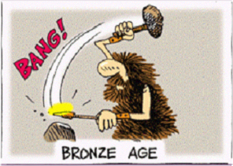
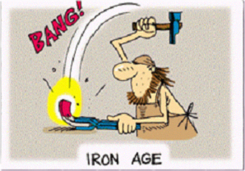
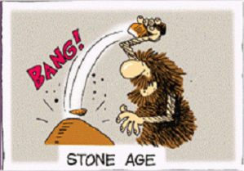
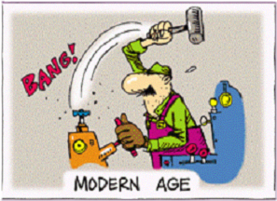
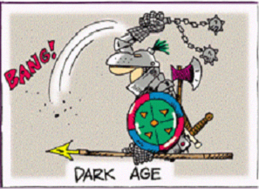
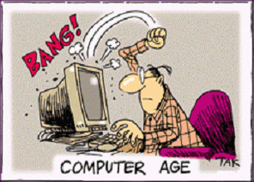
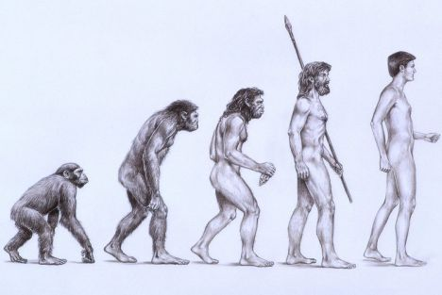
The development of a new technology
is hard and long ...
but ... nothing can stop evolution
Notes:
The old work of the Pathologist is going to evolve: let’s manage properly this evolution.

